Slide 1
The Deputy Head of Administration Of the urban district Lotoshino
A. E. Shagiev
The investment passport
urban district Lotoshino

Slide 2
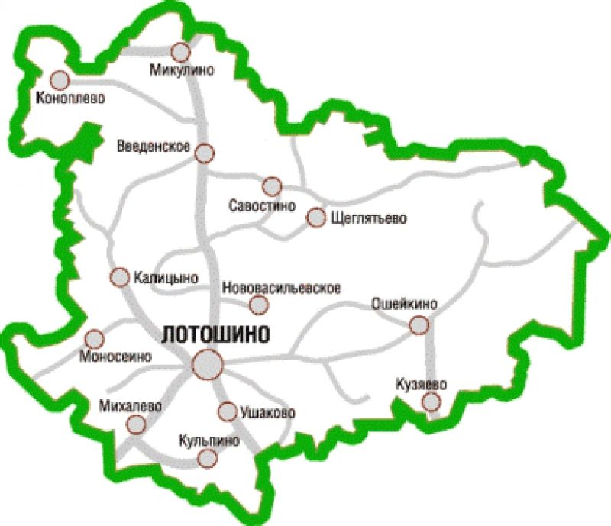
Geography
Карта Мун.Обр.
Urban district Lotoshino is located in the North-Western part of the Moscow region, bordering the Tver region, and as with Volokolamsk, Shakhovskyaya and Klin districts of the Moscow region.
Within a radius of 20 km there are 16,126 thousand people of potential consumers of products.
Описание:
м.р.
расположен
Urban district Lotoshino
140 km
80 km
Moscow
Tver

Slide 3
Demographics and resources
The area of the Moscow region is 97.98 thousand hectares.
•Administrative center — RP Lotoshino.
Composition of the district - 3 settlements: 1 urban, 2 rural.
•A population of 16,126 thousand people (on 01.01.2019 g) Urban areas – 4,937 thousand people of the countryside – 11,189 thousand.
•Able – bodied population of 8,312 thousand people In the district economy employs – 4,890 thousand people Due to commuting a personnel reserve of qualified labour forces of order – 2000 thousand people.
Minerals: peat
Cadastral value of land plots for placement
• houses IH: from 205 to 680 RUB. per sq. m.
• summer cottage and horticultural associations: from 160 to 290 RUB per sq. m.
• trade: from 790 to 1450 RUB per sq. m.
• industry: from 190 to 240 rubles per sq. m
Average monthly salary (thousand roubles)
•industry -21854,70
•agriculture - 30526,50
•trade – 29515,80
•education – 34967,70
•health – 43769,80
•culture and sport – 37293,5
Cost:
Electricity: from 3.89 to 5.56 rubles per 1 KW / hour
Gas supply: 6.56 roubles per 1 cubic metre.
Water supply: 22.95 roubles per 1 cubic metre, without VAT
Wastewater disposal: 45.21 roubles per 1 cubic metre, without VAT
Heat supply: 225.10 RUB / Gcal, without VAT

Slide 4
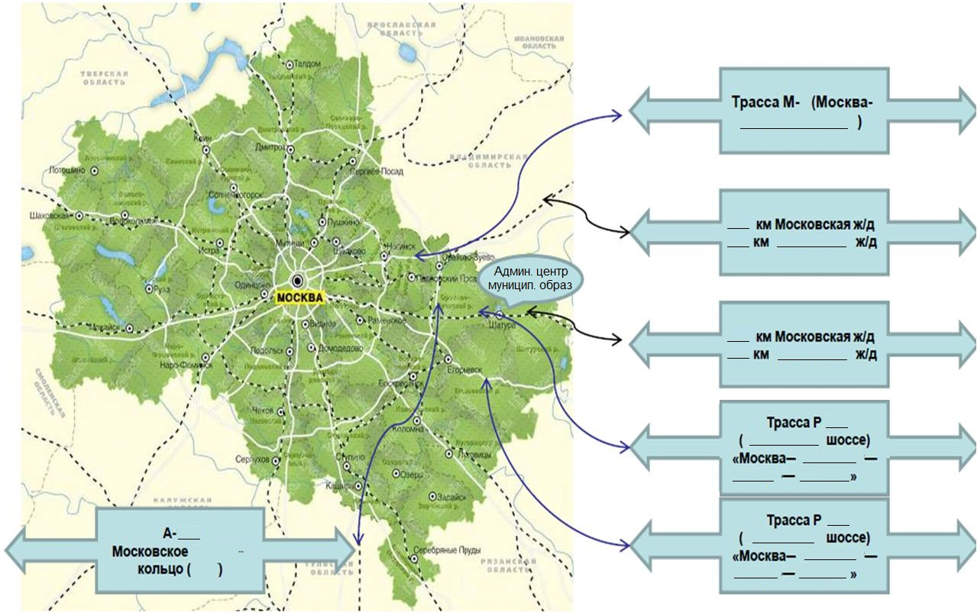
Transport connection

Slide 5
Education and skills
Education system:
Colleges-0
Schools – 0
• Colleges – 0
Other Universities-0
Number of pupils: 0 people (201_)
Areas of training:
engineers-0 people.
chemists-0 people.
economists-0 people.
construction business-0 people.
The main labor specialization of residents of the district:
The main areas of employment of residents are work in the public sector (primarily health and education, culture and sports), employment in budgetary organizations of environmental management (gosohotkompleks "Zavidovo", Lotoshinsky district forestry Volokolamsk’s forestry) and units of Federal and regional structures operating in the district (the structure of the interior Ministry, social security, communications hub), as well as agriculture and private business.

Slide 6
The large enterprise
MP "Lotoshinskoe housing»
*Investments – 0,542 million.
*Field of activity: provision of public services
*Production capacity by heat-71.1 Gcal / h
* Jobs-365 people.
4. OOO "RuMolokos" Department “Yarovoe»
*Investment volume - 45 million roubles.
*Field of activity: Agriculture
*Production capacity: Milk – 5642,8 t/year Meat beef – 240,3 t/year
* Jobs-151 people.
2. OJSC "Sovkhoz imeni Kirova»
Investment volume - 48 million roubles.
Field of activity: agriculture
Production capacity: Cow milk – 6050,4 t/year Meat beef – 153,9 t/year
Jobs-116 people.
5. OOO "RusMoloko" Department “Veshnie Vody»
*Investment volume - 28.7 million roubles.
*Field of activity: Agriculture
*Production capacity: Milk – 7440,2 t/year Meat beef – 274,4 t/year
* Jobs-135 people.
3. LLC " Precepts of Ilyich»* *Investment volume-6.7 million roubles.
*Field of activity:Agriculture
*Production capacity: Milk – 2885,1 t/year Meat beef – 141,9 t/year *
*Jobs-85 people.

Slide 7
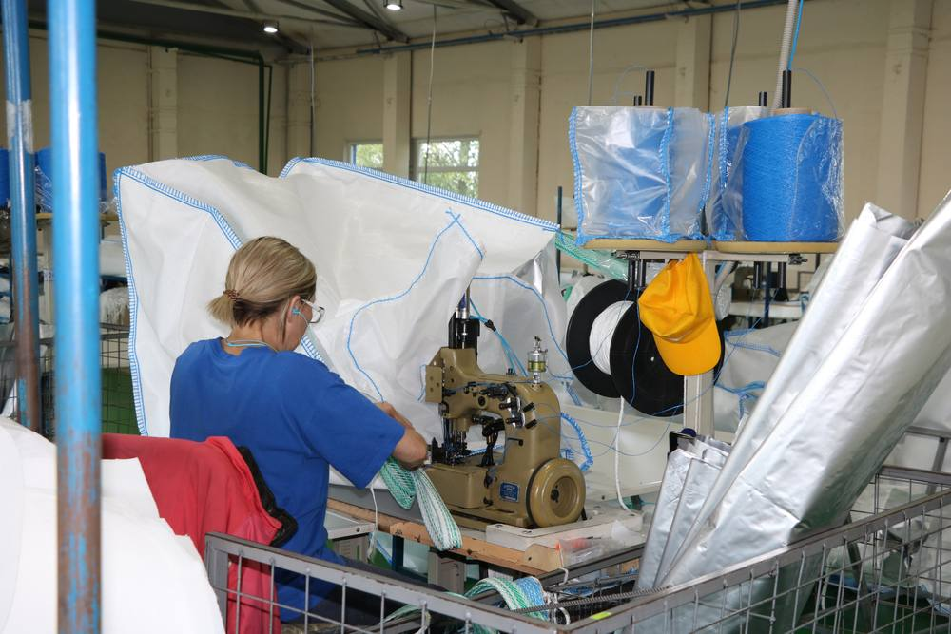
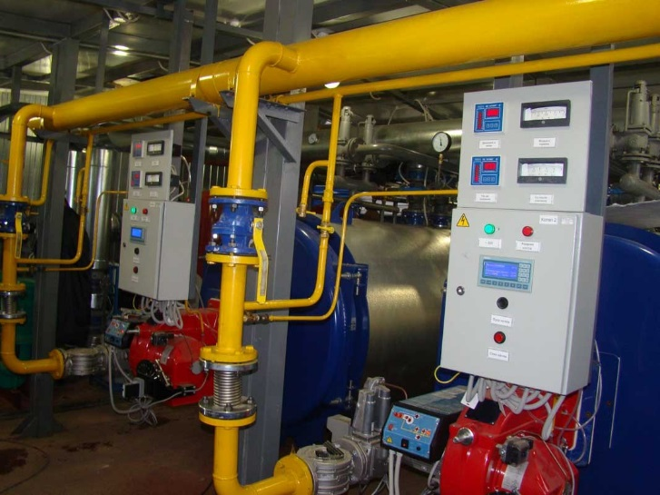
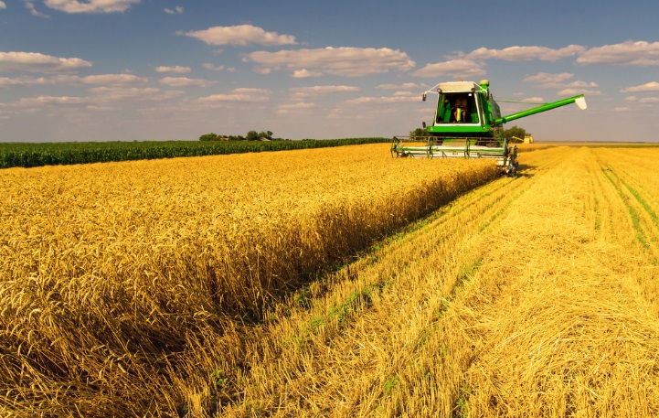
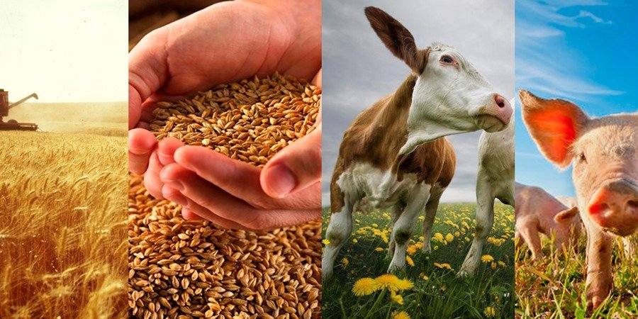
The large enterprise
OOO "Platform»
*The volume of investments – 250.0 million roubles.
*Field of activity: production of special soft packaging containers for bulk products (big bags)
*Production capacity – 298721 PCs.
* Jobs-120 people.

Slide 8
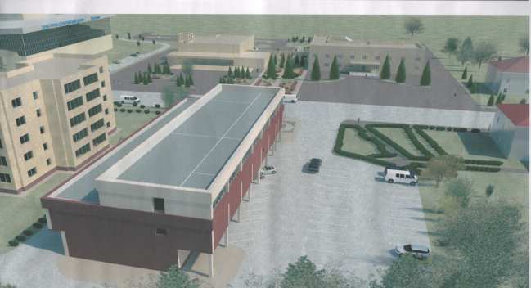
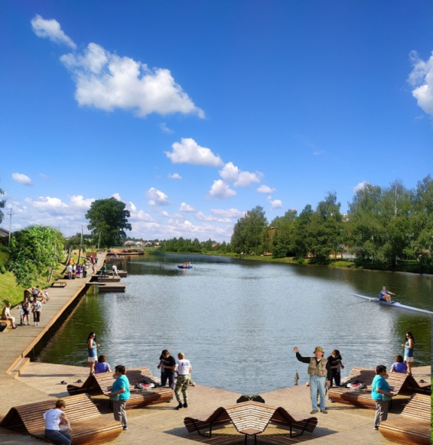
The list of potential and early stage investment projects (having a significant impact on the economy of the district, not related to the construction of housing and related facilities, as well as the construction of Federal and regional engineering infrastructure)
Logistics
No
Trade
"Reconstruction of the administrative building into a shop
With built-in office space"
at: 143800, Moscow. Region, urban district Lotoshino, Lotoshino,
Shkolnaya Street, d. 18
OOO "Stroyekspluatatsiya»
Industry
No
Industrial parks and technoparks
FE "Ushakov" 9 ha
Housing and communal services
No
Social sphere
Improvement of the Park of culture and rest at the address: 143800,
Moscow region, urban district Lotoshino, Lotoshino, Zavodskaya street
Improvement of recreation area " Krasniy Ruchey»
Transport
No
Agriculture
No

Slide 9
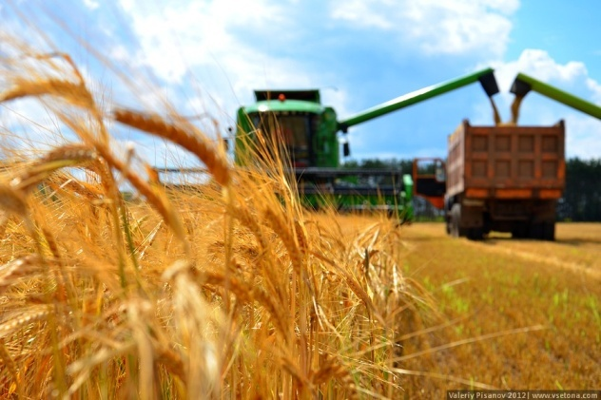
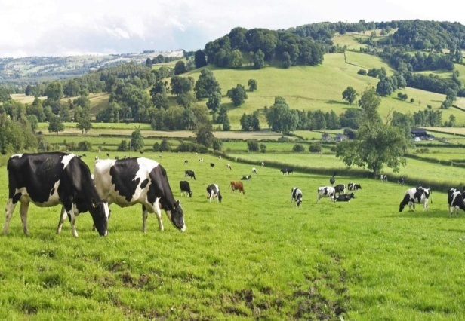
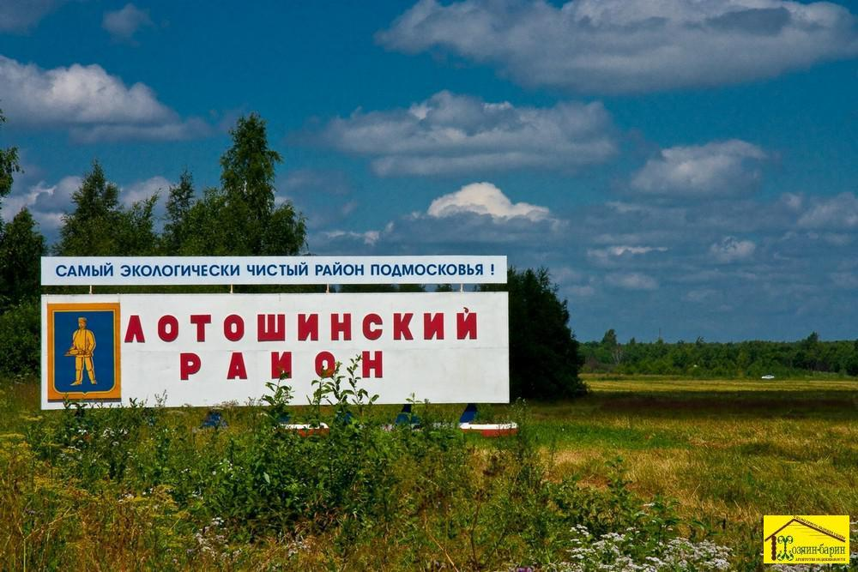
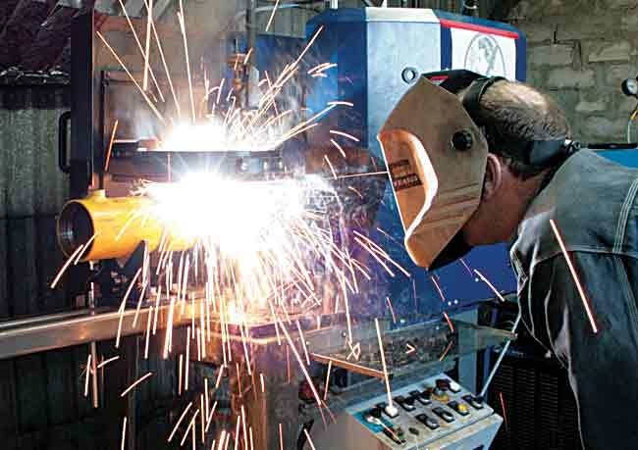
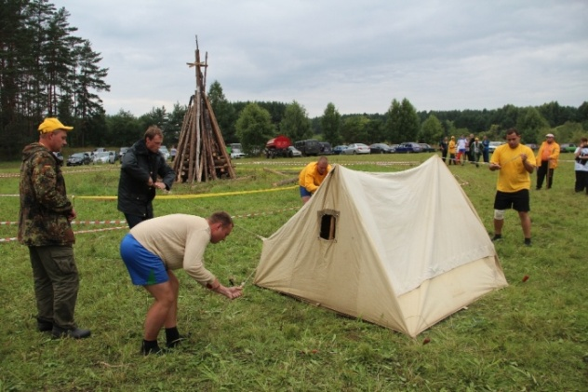
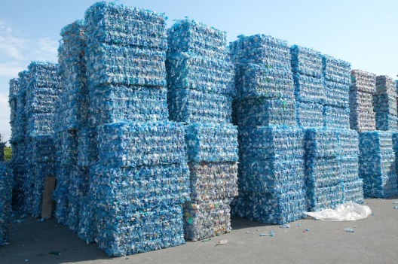
Priority sectors of development of the district to attract investment (the main specialization of business in the district)
Agriculture
Processing
Ecotourism

Slide 10
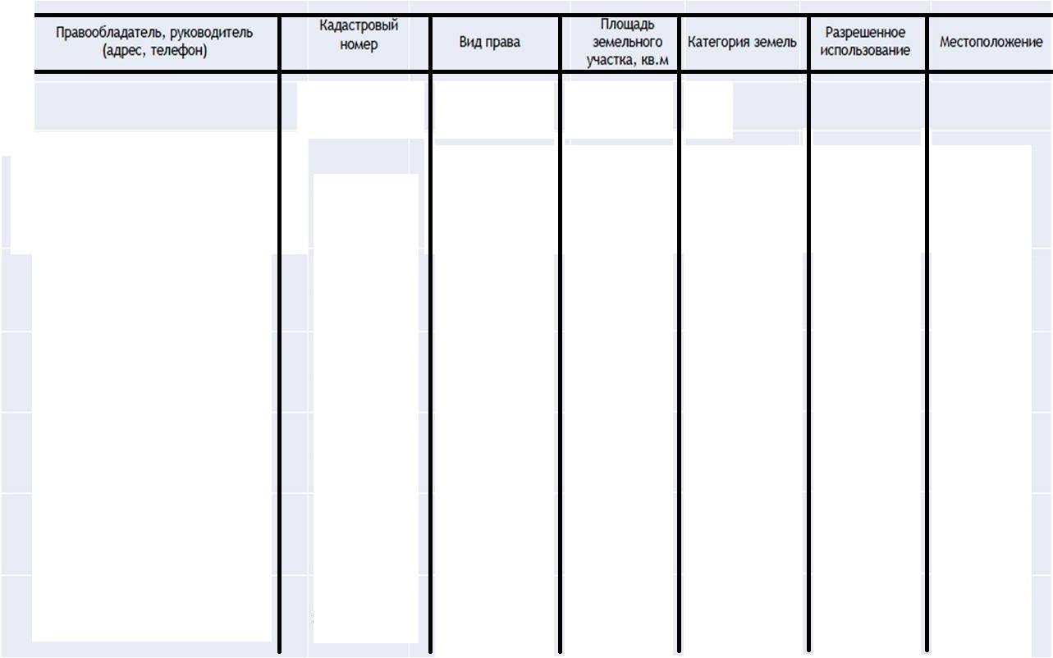
Promising for investment land, property complexes and free space at existing enterprises
The Administration Of The urban district Lotoshino
94564
The lands of settlements
To accommodate the facilities of the entrepreneur-activities
Moscow region, urban district Lotoshino, rural settlement Osheikinskoe, the village of Ushakovo
50:02:0040204:943
Municipal property
The Administration Of The urban district Lotoshino
50:02:0040220:138
Non-delimited state property
for the construction of shopping and entertainment complex
Moscow region, urban district Lotoshino, Kirovskiy
10000
The lands of settlements
Non-delimited state property
The lands of settlements
for agricultural production
Moscow region, urban district Lotoshino, rural settlement Mikulinskoe, the village of Mogiltsy
The Administration Of The urban district Lotoshino
50:02:0010410:129
7640
The Administration Of The urban district Lotoshino
for complex residential development of the residential District in Lotoshino
Moscow region, Lotoshinskiy urban district Lotoshino, nearWest street, North Central street
50:02:0030201:205
Municipal property
78700
The lands of settlements
The lands of settlements
for public services
Moscow region, Lotoshino urban district Lotoshino, Veterinary street
The Administration Of The urban district Lotoshino
50:02:0030102:901
Municipal property
20000

Slide 11
Promising for investment land, property complexes and free space at existing enterprises
The lands of settlements
To accommodate an indoor training ice rink
Moscow region, urban district Lotoshino, Kirovskiy
The Administration Of The urban district Lotoshino
50:02:0040110:221
Non-delimited state property
15000
The Administration Of The urban district Lotoshino
Non-delimited state property
The lands of settlements
For the construction of the clothing market
Moscow region, urban district Lotoshino, Lotoshino, Ramenskoye highway
50:02:0030204:255
27900
The Administration Of The urban district Lotoshino
Non-delimited state property
The lands of settlements
automobile transport
Moscow region, urban district Lotoshino, Lotoshino, Ramenskoye highway
50:02:0030204:797
10000
The land of industry, energy, transport, communications, broadcasting. Etc.
For the construction of cottages, sports and recreation facilities
Moscow region, urban district Lotoshino, About South of the village Osheikino
The Administration Of The urban district Lotoshino
50:02:0040408:1
Non-delimited state property
366000

Slide 12
Lotoshinskiy
Lotoshinsky district, Moscow region, 143800
Lotoshino, Tsentralnaya street, 18.
Dolgasova Ekaterina Leonidovna
The Head Of The municipal district
8(496-28)7-15-15, 8(496-28)7-09-82
Shagiev Alexander Eduardovich
The deputy Head of administration of Lotoshinsky municipal district
8(496-28)7-00-24
Nikolaev Vladimir Evgenievich
The deputy Head of administration of Lotoshinsky municipal district
8(496-28)7-00-10
Molyarova Lubov
Mikhailovna
The Head of Department for Economics and long-term development of PMT
8(496-28)7-19-65
Popov Vyacheslav Alexandrovich
The Head of the Department of architecture and urban planning, chief architect
8(496-28)7-03-24
Kozlovsky Vasily Yakovlevich
The Chairman of the property management Committee
8(496-28)7-03-56

Slide 13
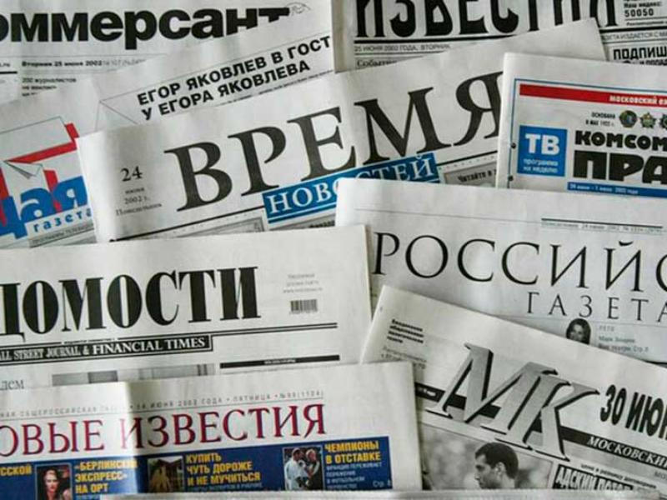
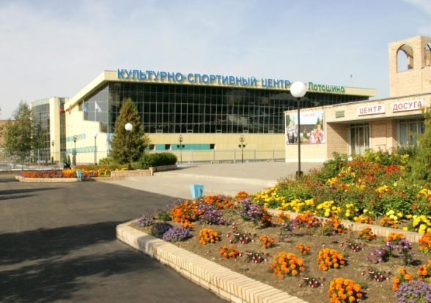
Demographics and resources
Useful information for investors
Leading municipal media
Газета
The address:143800, Moscow region, Lotoshino, Krasnoarmeyskaya street, 19
Telephone:8 (49628) 7-31-98
E-mail: lotoshino-inform@mail.ru
Интернет
The Administration website : Лотошинье.рф
Portal : Лотошинье.рф
E-mail: loto@mosreg.ru
Наше Лотошинье
Официальный сайт администрации Лотошинского муниципального района Московской области приветствует Вас!

Slide 14
Demographics and resources
Davydov Alexander Alekseevich
1. OOO "Lotoshinskiy Avtodor»
Production of civil works
on construction of bridges,
underground highways,
tunnels and underground roads
8 (496-28)706-28

